Slide 1
Social Media…

Slide 2
Social Media
Leverage through their network
Post a message welcoming them
Have them post about joining
Have them like and follow any pages or accounts for Sellstate and your office
Have them friend request other Advisors in the office and have others request the new Advisor
Make them familiar with any online groups that the Advisors communicate through

Slide 3
Social Media
Leverage through their network
Pictures are important
Tagging is important
Boosting this post could be worth it if the new Advisor has a positive reputation in the area

Slide 4
Agent Asset Development…

Slide 5
Agent Asset Development Program
Equipping your Advisors
Make sure they understand the benefits of the program
Get two (2) to three (3) names from them
Have them go out and immediately contact people
When someone first joins is when they’re most excited and enthusiastic

Slide 6
Agent Asset Development Program
Equipping your Advisors
Make sure they have promotional material
Mare sure they know where to get more promotional material

Slide 7
Agent Asset Development Program
Follow-up
This is the time to schedule a follow-up meeting about the two (2) or three (3) names
Get them in the habit of making AAD prospecting part of their business
They are not used to this, but Sellstate is different, which is why they joined you

Slide 8
Send to Advisor…

Slide 9
Send to Advisor
Get them information immediately
Add the new Advisor to your email list immediately
Send them something welcoming with useful information
Follow-up with them to ensure they received it
This process should be automatic as new recruits come onboard

Slide 10
Send to Advisor
Get them information immediately
Send them an email summarizing the orientation information
  Important contact information for key office personnel
  User names and passwords for accounts created
  Door codes
  Office WiFi
  Copier codes
  Where to find extra supplies
  Printer installation instructions
  The education calendar
  Reminders of any office policies

Slide 11
Who does what…

Slide 12
Who Does What?
Because this isn’t all on your plate
Dividing up the key tasks is very important
The office team members should each know which part they are responsible for and be accountable to its completion
There is no hard fast rule as to who should be doing which part of this
The program has to work for your office environment and setup
What’s vital is that the entire process gets done!

Slide 13
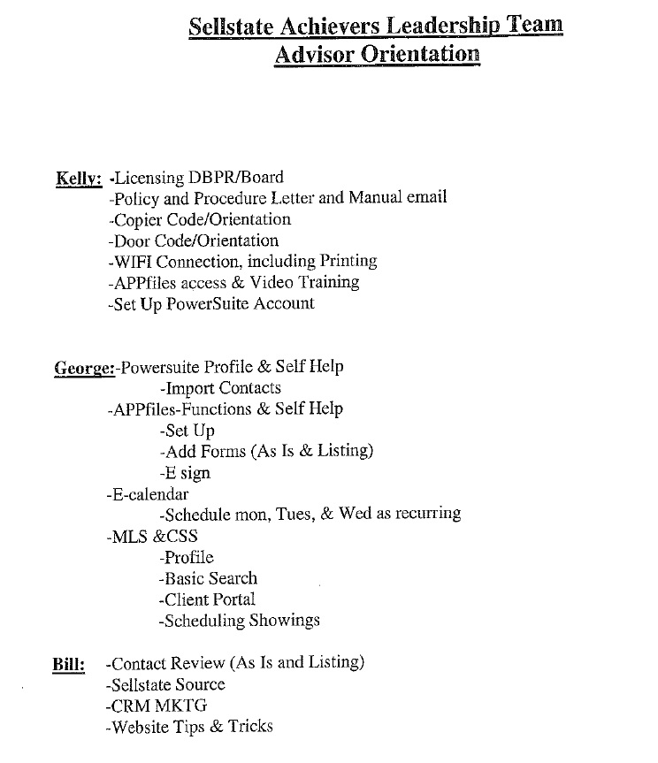
Who Does What?
Example of a breakdown

Slide 14
But what about ongoing support?…

Slide 15
Ongoing Support
Without it, the process is pointless
The support of the onboarding program is arguably as important as the program itself
The support should be broken up and divide among the office team
Have the appropriate person supporting the appropriate tasks
Once again this has to work for your office arrangement
It probably makes sense to assign support based upon which sections of the onboarding were covered
The entire support program should not be on you!

Slide 16
That was intense…

Slide 17
Let’s wrap up…

Slide 18
What We Covered
A thing or two…
What onboarding is
The importance of a strong onboarding program
The basics
The office tour
Paperwork
Business materials
Office cloud
Power Suite
Social media
AAD
Sending out initial material to Advisors
Who does what
Support
We also watched a pretty amazing video

Slide 19
One more thing before we go…

Slide 20


Slide 21
You’re welcome!
Presenter:
Michael Darmanin
Chief Operating Officer
I hope you enjoyed the show!

