Slide 1
Advantage
SELLSTATE

Slide 2
About Me
Jim Doe
[INSTERT YOUR BIO HERE]
Phone Number: (239) 867-5309
Email: jimdoe@sellstateoffice.com
Website: www.jimdoesells.com
SELLSTATE

Slide 3
UNPARALLELED SERVICE AND TECHNOLOGY
My team and I take professionalism to new heights, I am working with a highly dedicated team to bring you the best experience possible. I utilize strategies that are seldom seen in real estate, the entire process will surpass your expectations.
Services Provided
Local, National and Global Marketing
Enhanced Placement on World Leading Sites
Consultation on Maximizing Property Value
Listing Integration into Social Media
Top Notch Closing Team
Expert Neighborhood Analysis
Comprehensive Property Evaluation
Market Trend Analysis

Slide 4
DIGITAL MARKETING
I’m able to promote your home in a comprehensive way using the latest technology, marketing, and social medial tools and techniques available

Slide 5
ENHANCED LISTINGS
With millions of homes for sale it’s not enough to simply appear on search sites. Through my strategic alliances with top websites such as Zillow, Homes.com and Trulia your home’s listing will receive special enhancements helping it stand out from the crowd.

Slide 6
ADVANCED LEVEL GLOBAL MARKETING
Sellstate has strategic alliances with Zillow.com and Homes.com, two of the largest home search sites in the world.
Your home will be marketed globally to take advantage of any foreign buyers moving to or investing in the area. With global coverage, all Sellstate listings have a monthly consumer reach of over
200,000,000+
Unique Visitors
Sellstate Power Suite can create detailed market demographic reports to provide you with current market trends.
Power Suite also allows Sellstate the ability to create professional marketing materials to promote every home to it’s fullest potential.
At Sellstate, our Real Estate Advisors will expose you to an incredible level of service and global marketing that is unparalleled in our industry
-Sellstate
SELLSTATE

Slide 7
LISTING SYNDICATION
Your home will be exposed to hundreds of millions of monthly viewers through syndication to all the major home search websites.

Slide 8
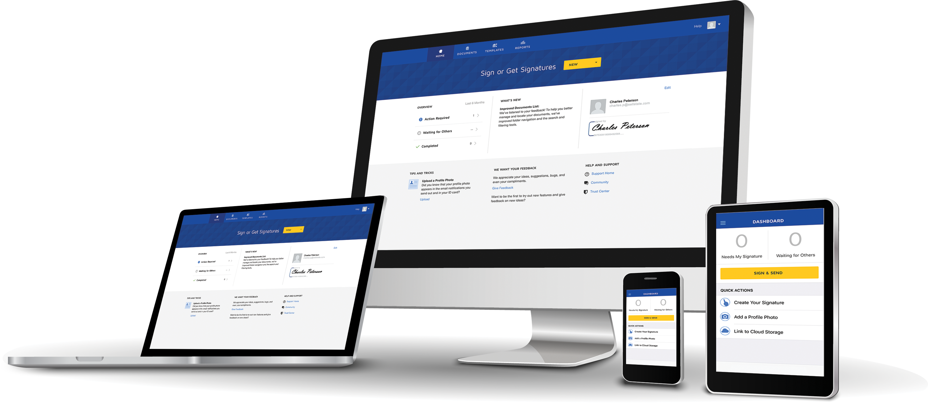
EASY TRANSACTIONS
Enjoy easy, paperless transactions with auto-fill forms that make the home selling process smoother than ever!

Slide 9
Why Sellstate?
A unique separate and distinct website for every property
Highly skilled Real Estate Advisors
200+ million consumer monthly reach
Social Media integration and marketing
Global marketing
Latest technology
Market knowledge
Market center
Licensed and insured
SELLSTATE

